Slide 1
Reflecting on the Strangest Election in the History of the U.S. and Its Implications for the Future
Christopher W. Larimer
Professor of Political Science
Graduate Coordinator for Master of Public Policy program
Prepared by Christopher W. Larimer, University of Northern Iowa, for talk with Waverly (IA) Branch of AAUW on March 18, 2021.
Please do not cite without the author’s permission.

Slide 2
Putting 2020 in proper context
“most Americans — upward of 80 percent to 85 percent — follow politics casually or not at all. Just 15 percent to 20 percent follow it closely (the people we call “deeply involved”)…For partisans, politics is a morality play, a struggle of good versus evil. But most Americans just see two angry groups of people bickering over issues that may not always seem pressing or important.”
Source: Yanna Krupnikov and John Barry Ryan
https://www.nytimes.com/2020/10/20/opinion/polarization-politics-americans.html
Prepared by Christopher W. Larimer, University of Northern Iowa, for talk with Waverly (IA) AAUW on March 18, 2021. Please do not cite without the author’s permission.

Slide 3
Activists and nonactivists---voters and nonvoters
“You have to have a lot less problems to worry about politics.”
Source: https://www.nytimes.com/2019/09/24/upshot/many-americans-not-polarized.html
“They [politicians] rent space in my brain and they frustrate me, but in the end, they do what they want anyway.
Source: https://www.nytimes.com/2020/10/26/us/election-nonvoters.html
Prepared by Christopher W. Larimer, University of Northern Iowa, for talk with Waverly (IA) AAUW on March 18, 2021. Please do not cite without the author’s permission.

Slide 4
Source: Dassonneville, Ruth, and Charles Tien. 2021. “Forecasting the 2020 US Elections.” PS: Political Science & Politics 54(1): 48-51 (Table 2 from p. 49).
Prepared by Christopher W. Larimer, University of Northern Iowa, for talk with Waverly (IA) AAUW on March 18, 2021. Please do not cite without the author’s permission.

Slide 5
Source: Grant, Adam. 2021. Think Again: The Power of Knowing What you Don’t Know. New York: Viking Press (p. 4).
“Reconsidering something we believe deeply can threaten our identities, making it feel as if we’re losing a part of ourselves.
“Rethinking isn’t a struggle in every part of our lives. When it comes to our possessions, we update with fervor. We refresh our wardrobes when they go out of style and renovate our kitchens when they’re no longer in vogue. When it comes our knowledge and opinions, though, we tend to stick to our guns. Psychologists call this seizing and freezing. We favor the comfort of conviction over the discomfort of doubt, and we let our beliefs get brittle long before our bones. We laugh at people who still use Windows 95, yet we still cling to opinions that we formed in 1995. We listen to views that make us feel good, instead of views that make us think hard.” (p. 4)
Prepared by Christopher W. Larimer, University of Northern Iowa, for talk with Waverly (IA) AAUW on March 18, 2021. Please do not cite without the author’s permission.

Slide 6
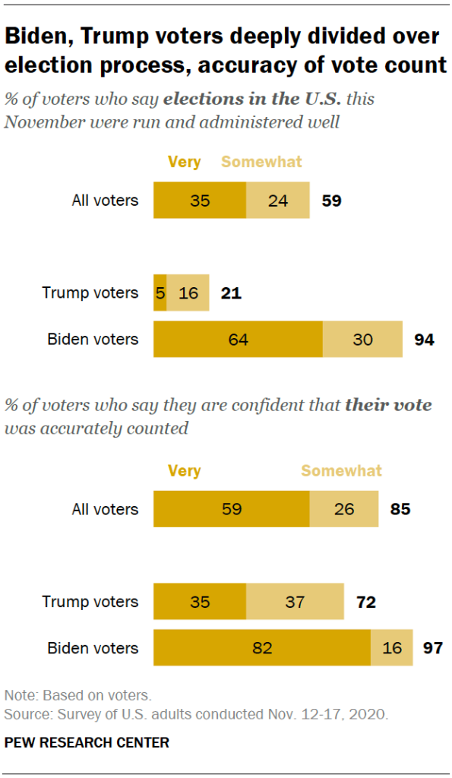
Source: Pew Research Center, November 19, 2020: https://www.pewresearch.org/politics/2020/11/20/sharp-divisions-on-vote-counts-as-biden-gets-high-marks-for-his-post-election-conduct/pp_2020-11-20_post-election_0-01/
“Do you believe there was widespread voter fraud in the 2020 presidential election, or not?”
Source: Quinnipiac Poll January 11, 2021: https://poll.qu.edu/national/release-detail?ReleaseID=3686
Prepared by Christopher W. Larimer, University of Northern Iowa, for talk with Waverly (IA) AAUW on March 18, 2021. Please do not cite without the author’s permission.

Slide 7
Source: Morning Consult poll, released January 27, 2021: https://morningconsult.com/form/tracking-voter-trust-in-elections/
Prepared by Christopher W. Larimer, University of Northern Iowa, for talk with Waverly (IA) AAUW on March 18, 2021. Please do not cite without the author’s permission.

Slide 8
Gideon Rose, Foreign Affairs
“We now know that humans are cognitively biased against reason. Our brains are hardwired to make us emotional, volatile, and tribal. We act according to personal webs of meaning that do not necessarily overlap with those of others.” (p. 53; March/April 2021)
Prepared by Christopher W. Larimer, University of Northern Iowa, for talk with Waverly (IA) AAUW on March 18, 2021. Please do not cite without the author’s permission.

Slide 9
Hope vs. No hope
No voter persuasion
Kalla, Joshua L., and David E. Brookman. 2018. “The Minimal Persuasive Effects of Campaign Contact in General Elections: Evidence from 49 Field Experiments.” American Political Science Review 112(1): 148-66.
Coppock, Alexander, Seth J. Hill, and Lynn Vavreck. 2020. “The small effects of political advertising are small regardless of context, message, sender, or receiver: Evidence from 59 real-time randomized experiments.” Science Advances 6(36): 1-6.
BUT…
Kalla, Joshua A., and David E. Broockman. 2020. “Reducing Exclusionary Attitudes through Interpersonal Conversation: Evidence from Three Field Experiments.” American Political Science Review 114(2): 410-25.
Gerber, Alan S., Gregory A. Huber, David Doherty, Conor M. Dowling, and Seth J. Hill. 2013. “Do Perceptions of Ballot Secrecy Influence Turnout? Results from a Field Experiment.” American Journal of Political Science 57(3): 537-71.
Prepared by Christopher W. Larimer, University of Northern Iowa, for talk with Waverly (IA) AAUW on March 18, 2021. Please do not cite without the author’s permission.

Slide 10
Where are we?
2018 trending BLUE?
2020 trending RED!
*2021…now what?
Reynolds +3 in 2018
Dems. +3 in U.S. House
Dems. +5 in Iowa House
Dems. win State Auditor
Trump +8.2 in 2020 (+9.4)
Ernst +6.6 in 2020
GOP +3 in U.S. House
GOP +6 in Iowa House
Grassley +10 (48)
Reynolds -1
Ernst -3
Biden +3
Majority against
Grassley running (55%)
Reynolds running (52%)
Pandemic
Biden +20
Reynolds -4
*Source: The Des Moines Register/Mediacom Iowa Poll (March 2021)
Prepared by Christopher W. Larimer, University of Northern Iowa, for talk with Waverly (IA) AAUW on March 18, 2021. Please do not cite without the author’s permission.

Slide 11
Control of Iowa legislature, 1969-2021
Source: Iowa Secretary of State
Prepared by Christopher W. Larimer, University of Northern Iowa, for talk with Waverly (IA) AAUW on March 18, 2021. Please do not cite without the author’s permission.

Slide 12
Other books mentioned
Securitarian Personality by John Hibbing
How America Lost Its Mind by Thomas Patterson
Bases Loaded by Costas Panagopoulos
American Rage by Steven Webster
Prepared by Christopher W. Larimer, University of Northern Iowa, for talk with Waverly (IA) AAUW on March 18, 2021. Please do not cite without the author’s permission.

