Slide 1
1619 Project
Community Read

Slide 2
Housekeeping / Introductions
American Association of University Women (Waverly Branch)
City of Waverly Human Equity and Diversity Commission
Wartburg Multicultural Student Services
EMBRACE
Notes:
AAUW website resources review
Introduce table facilitators as well

Slide 3
Norms / Agreements for Sessions
Listen/observe for understanding
Monitor airtime
Assume positive intent
Experience discomfort
Come prepared
Be civil

Slide 4
Icebreaker
Who are you?
Why did you decide to participate in this community read?

Slide 5
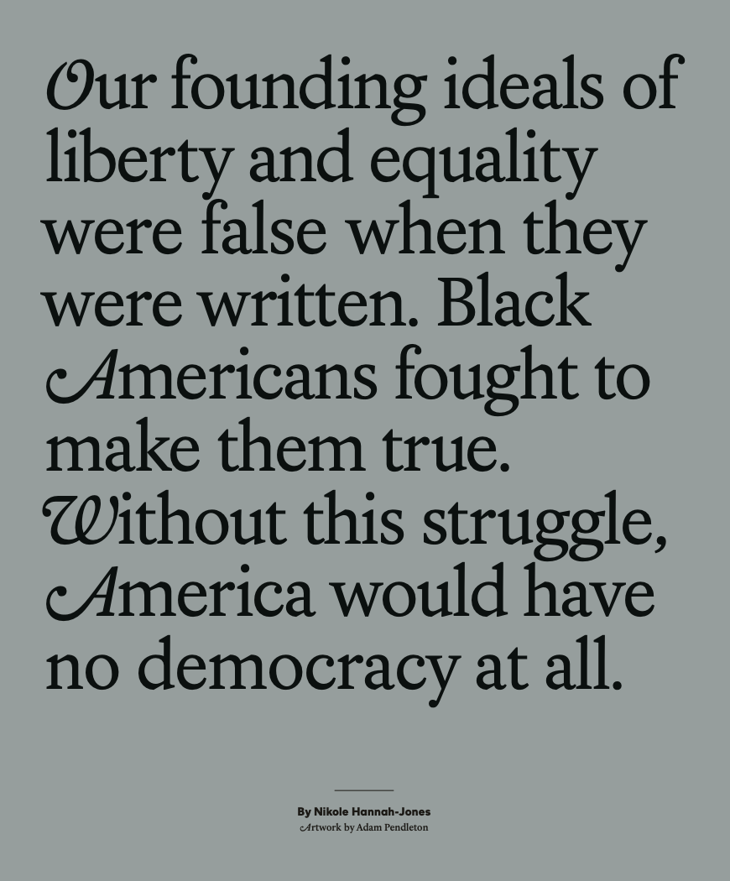
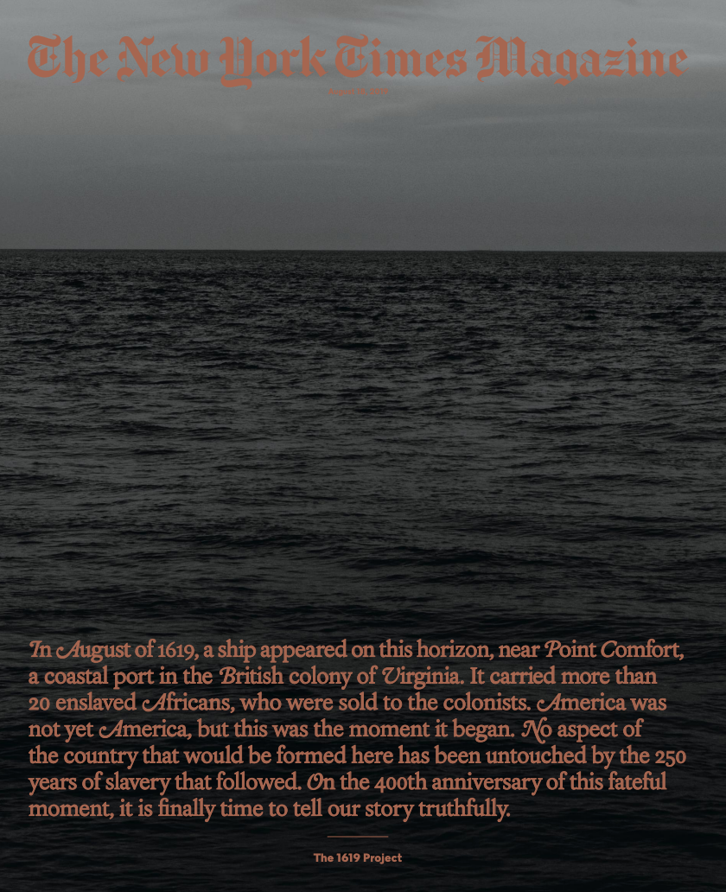
The Idea of America
By Nikole Hannah-Jones
Pages 14-26
Notes:
Nikole Hannah-Jones: The Idea of America

Slide 6
Discussion Questions:
1a. How have U.S. laws, policies, and practices oppressed Black Americans since 1619?
1b. How have Black Americans fought back against oppression and worked to build a better society for all?

Slide 7
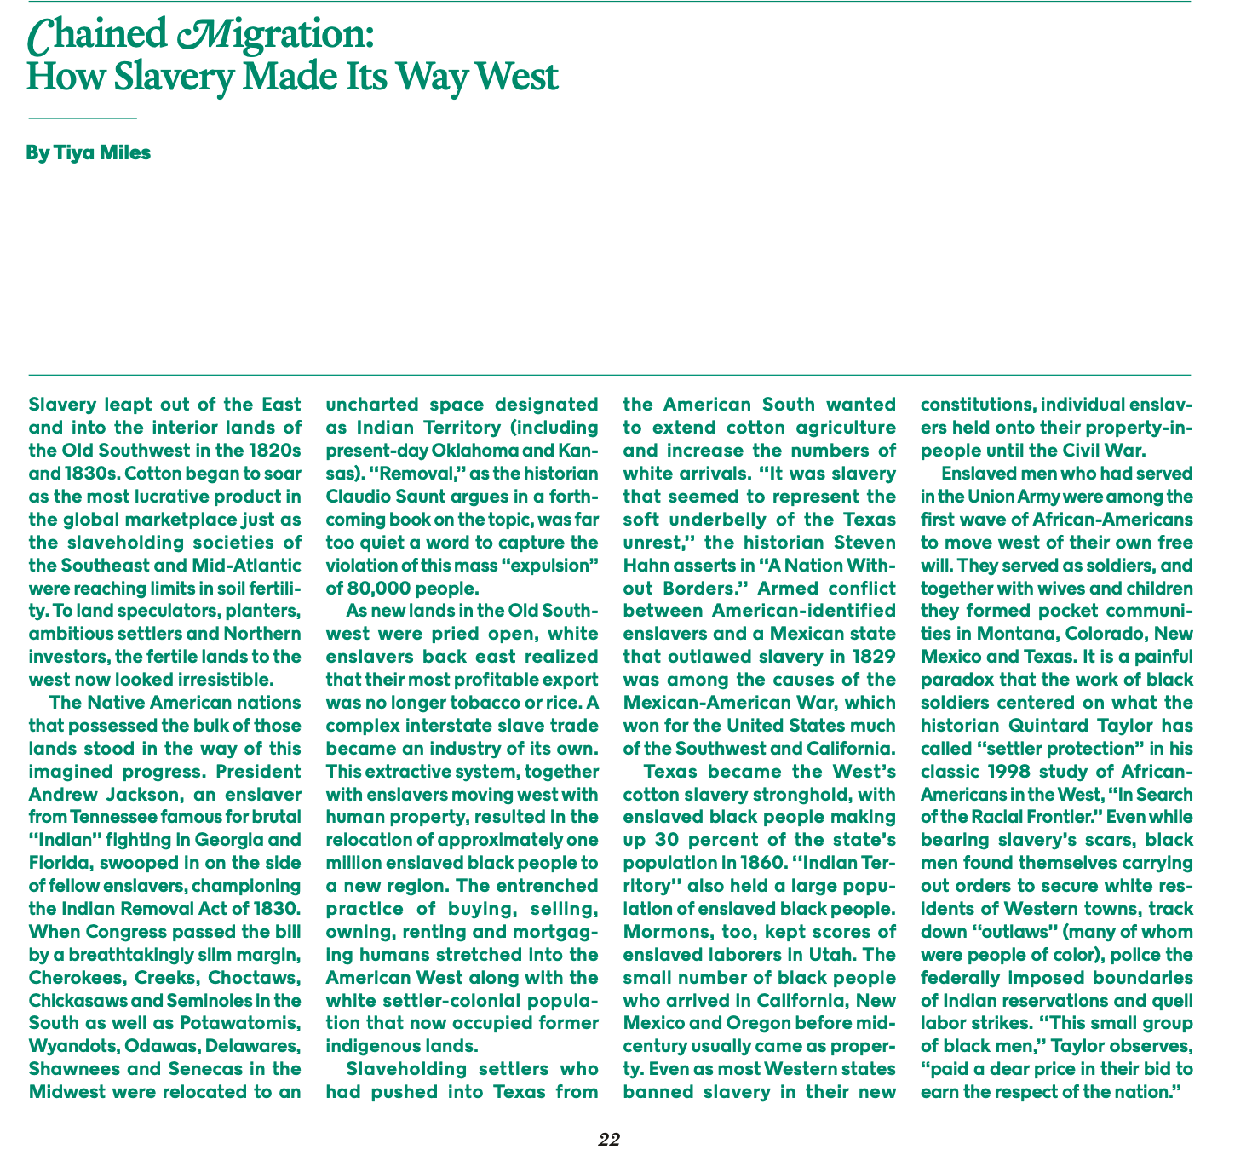

Slide 8
Discussion Questions:
2a. How was the expansion of the US shaped and made possible by slave labor?
2b. When did free Black Americans begin to travel west? Why?

Slide 9
Discussion Questions:
3. What surprised you as you read these articles?
4. What new learning created discomfort for you?

Slide 10
Discussion Questions:
5. How has your idea of what it means to be “American” changed as a result of these articles?
6. How has your definition of patriotism changed as a result of reading these articles?

