Slide 2
2022 ERA - It’s About Time
1776
1846
1848
1848-1920
1919-1920
1920
1923
1923-1970

Slide 3
2022 ERA - It’s About Time
1972
1975-1985
1977
1982
2014
2020
2021
2022

Slide 4
BRIEFING ROOMStatement from President Biden on the Equal Rights Amendment
JANUARY 27, 2022•STATEMENTS AND RELEASES
Today, as the House announces a resolution on the Equal Rights Amendment, I once again want to express my support for the ERA loudly and clearly. I have been a strong supporter of the ERA ever since I first ran for the Senate as a 29-year-old. We must recognize the clear will of the American people and definitively enshrine the principle of gender equality in the Constitution. It is long past time that we put all doubt to rest. I am calling on Congress to act immediately to pass a resolution recognizing ratification of the ERA. As the recently published Office of Legal Counsel memorandum makes clear, there is nothing standing in Congress’s way from doing so. No one should be discriminated against based on their sex—and we, as a nation, must stand up for full women’s equality.
###

Slide 5
https://CattCenter.IAState.edu
Menu For Educators Resources for Educators “The Equal Rights Amendment at 100 Years: History and Current Issues” . . . Curriculum for Iowa High School students

Slide 6
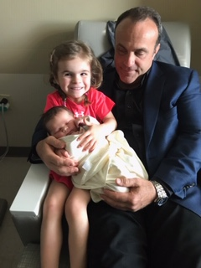
Dads for Equality
“They may not understand this yet; but, my daughters are entitled to the same opportunities, compensation and access for advancement as your sons. As they begin to realize this they will also see dad demand it for them.”
Eric E. Kelley, Ph.D., Professor
WVU, School of Medicine, Dept. Physiology and Pharmacology

